Slide 1
Linking Environmental Variables and NFL Receiving Stats: A 2023 Analysis
SAL 603 Final Project by Reese Michaels

Slide 2
Introduction

Slide 3

Background
Receiving statistics are an indicator of overall offensive team success, reflected by scoring impact, ability to move the ball downfield, individual player performance, etc.
Receiving TDs
Receiving Yards
1st Downs
Targets & Receptions
Y/R
Catch Rate (%)
Performance may be impacted by a host of constraints: individual, environmental, strategic, etc.
Notes:
Especially in today’s pass-heavy NFL where more teams are utilizing air raid strategies compared to run-based strategies → meaning, receiving stats play a bigger role than ever in defining offensive team success
Individual = athletic ability, game knowledge, conditioning level, injury history
Environmental = playing surface, weather, climate, time of day, crowd, etc.
Strategic = game strategy, understanding of playcalls, opponent playcalls, etc.

Slide 4
Research Question: Do temperature, wind speed, or playing surface impact team receiving statistics?
Selected Statistics: Catch %, Y/R, TD, 1D
Notes:
Temp and wind defined here as: # cold games, # moderate games, # warm, # hot, # slow, # medium, # windy
Playing surface defined as: # games played on grass, # games played on turf

Slide 5
Methods

Slide 6


Data Acquisition
Player-level receiving statistics retrieved from Pro Football Reference via CSV download
Includes all players that logged a reception for the 2023 NFL season
Historical game-level data retrieved from nflverse/nfldata GitHub repository via CSV download
Includes games from 1999-2023 along with data like home and away team, results, coaches, conditions, etc.

Slide 7



Libraries

Slide 8
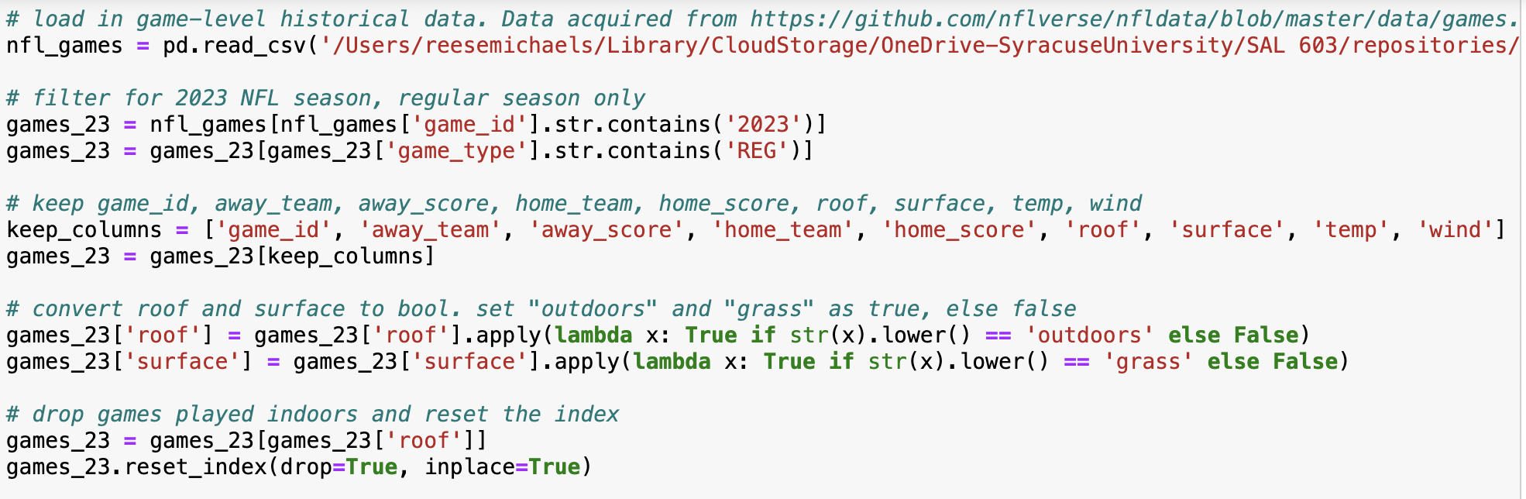
Preprocessing and Cleaning
Data loaded in as DataFrame
Data filtered for desired statistic columns; season, game type rows
Desired columns converted to Boolean
Drop select rows and columns
NaNs imputed with numeric mean
Notes:
This example = historical game dataframe
What was filtered for here = game id and game type rows, id, home team, away team, roof, surface, temp, wind
Bool = T/F value that can be aggregated later on. In the case of roof, stadiums with roof==true were eventually dropped for the first weather analysis

Slide 9
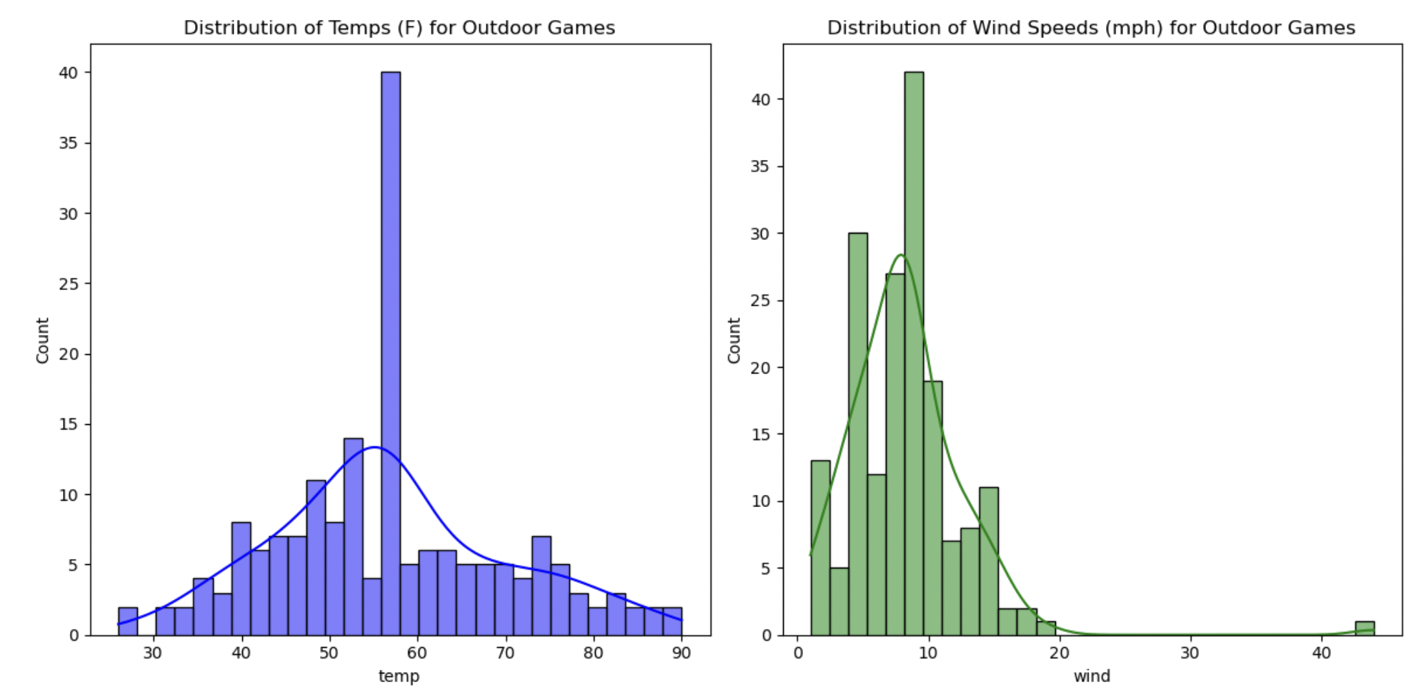
Manipulation and Aggregation
Check distributions for temperature and wind speed to determine class bins
Create categorical columns to hold number of games per class (# hot games, # fast wind games, etc.)
Group by home team and calculate counts for each condition, repeat for away teams. Assign to separate DataFrames
Merge home and away DataFrames on team to get a total count for each team for each condition
Merge resultant DataFrame with receiving stats DataFrame for one comprehensive table grouped by team
Notes:
This example = historical game dataframe
Histograms show relatively normal distribution – high points = imputed numeric mean NaN values
The bins that were determined were: cold, moderate, warm, hot
temp_bins = [25, 54, 62, 75, np.inf]
# classify wind speed into three bins: slow, moderate, fast
wind_bins = [0, 6, 11, np.inf]
Other notes: data normalization using sklearn minmaxscaler,
Acronym mapping for consistency

Slide 10
Analyses & Results

Slide 11
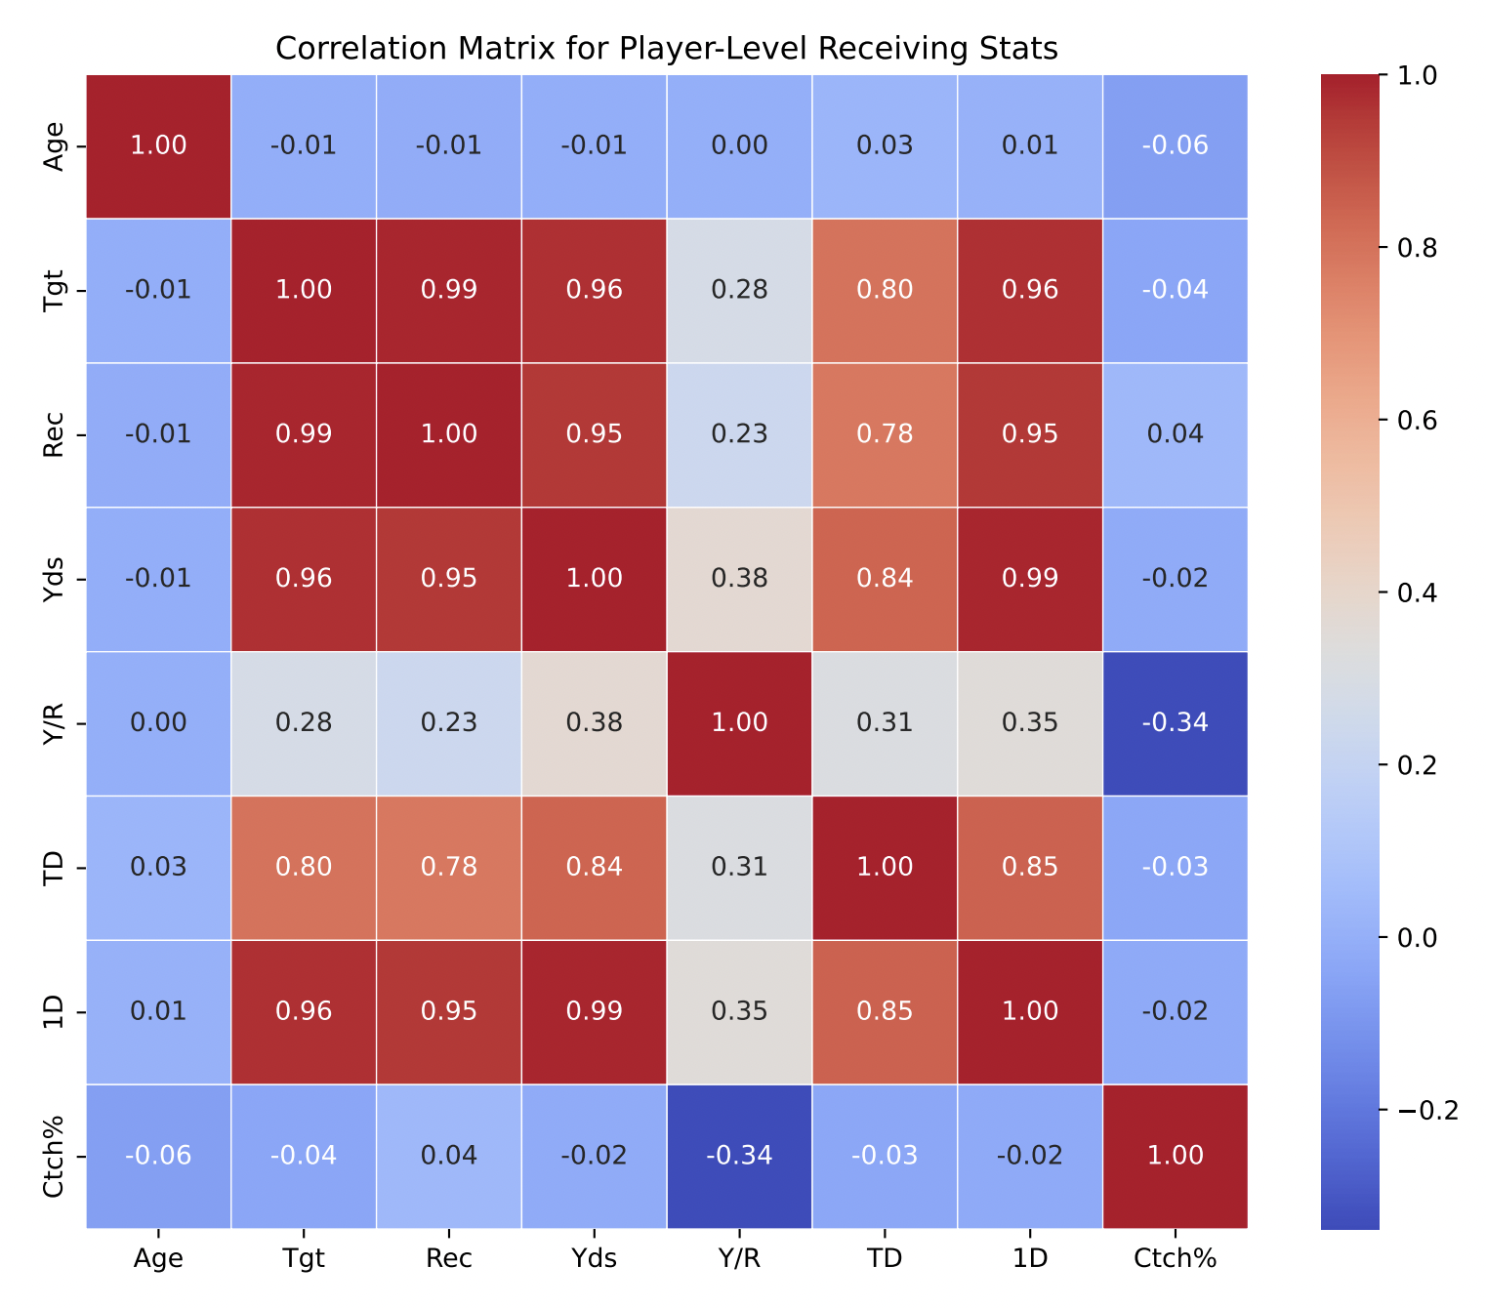
Receiving Stat Correlations
Notes:
Catch rate % doesn't correlate well with the other metrics.
Targets, receptions, yards, 1st downs all have very strong correlations with each other, since these metrics are derived from each other.
TD has a relatively strong correlation with targets, receptions, yards, and 1D. Unlike the other metrics, receiving TDs are not as strongly associated with the number of targets, receptions, or yards a receiver has; i.e., some receivers are bigger red zone threats than others, other receivers prioritize receptions and yards over TDs.

Slide 12
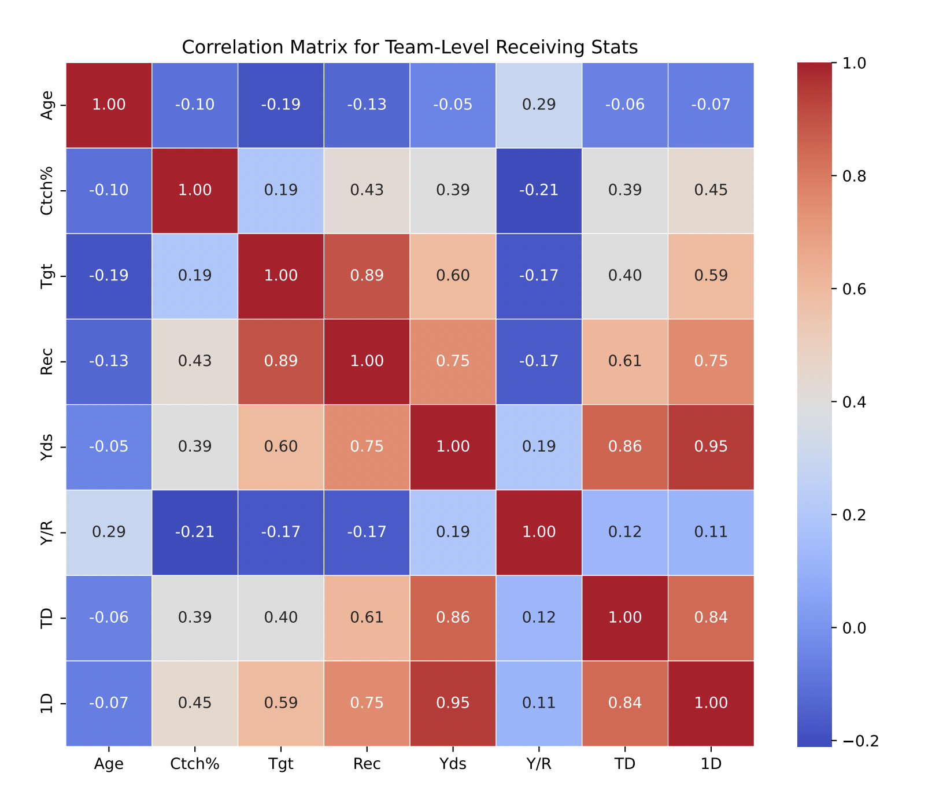
Receiving Stat Correlations
Notes:
Same general trends as individual level but slightly less strong correlations because of grouped data

Slide 13
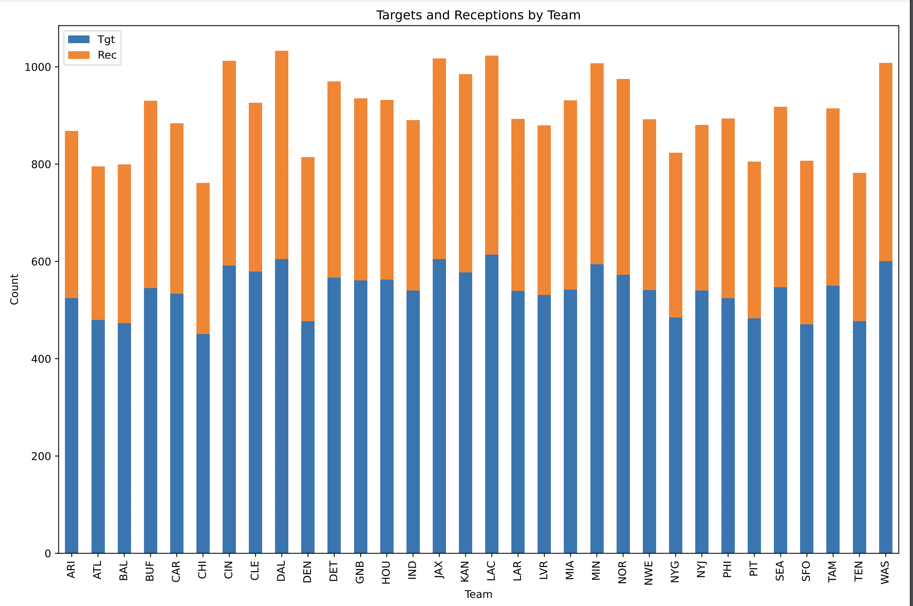
Team-Level Descriptive Stats
Notes:
This graphic isn’t super informative → DAL, JAX, LAC, MIN, WAS have the highest number of receptions – not very indicative of team success

Slide 14
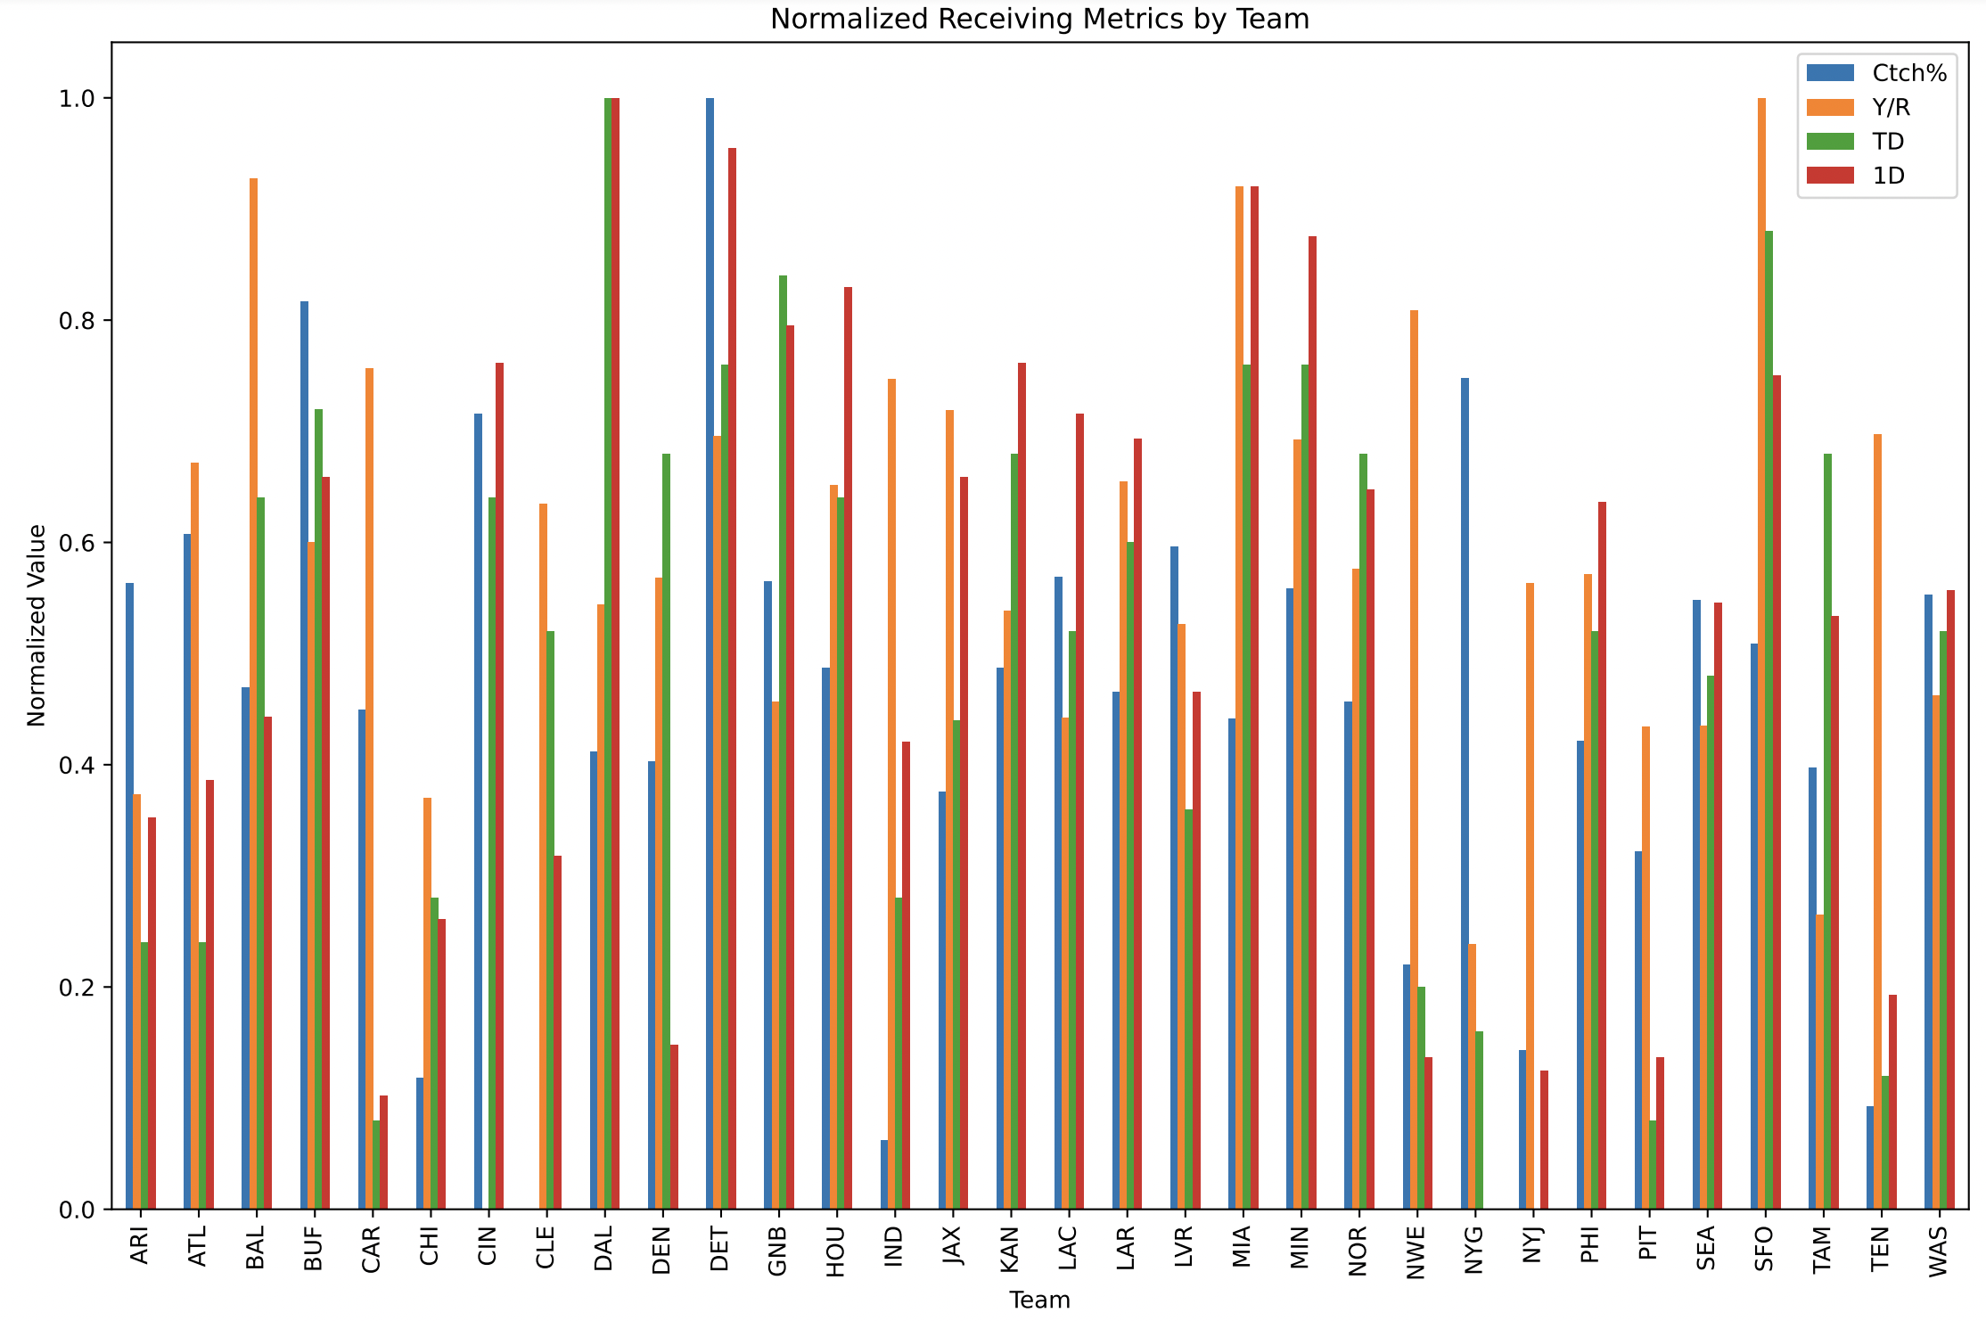
Team-Level Descriptive Stats
Notes:
Takeaways here = SF highest Y/R, DAL highest TD and 1D, DET pretty solid overall, MIA pretty solid overall
Some of the really bad passing teams (CAR, PITT, TEN) have pretty low TD and 1D
This makes sense – these were some of the top passing offenses in 2023

Slide 15
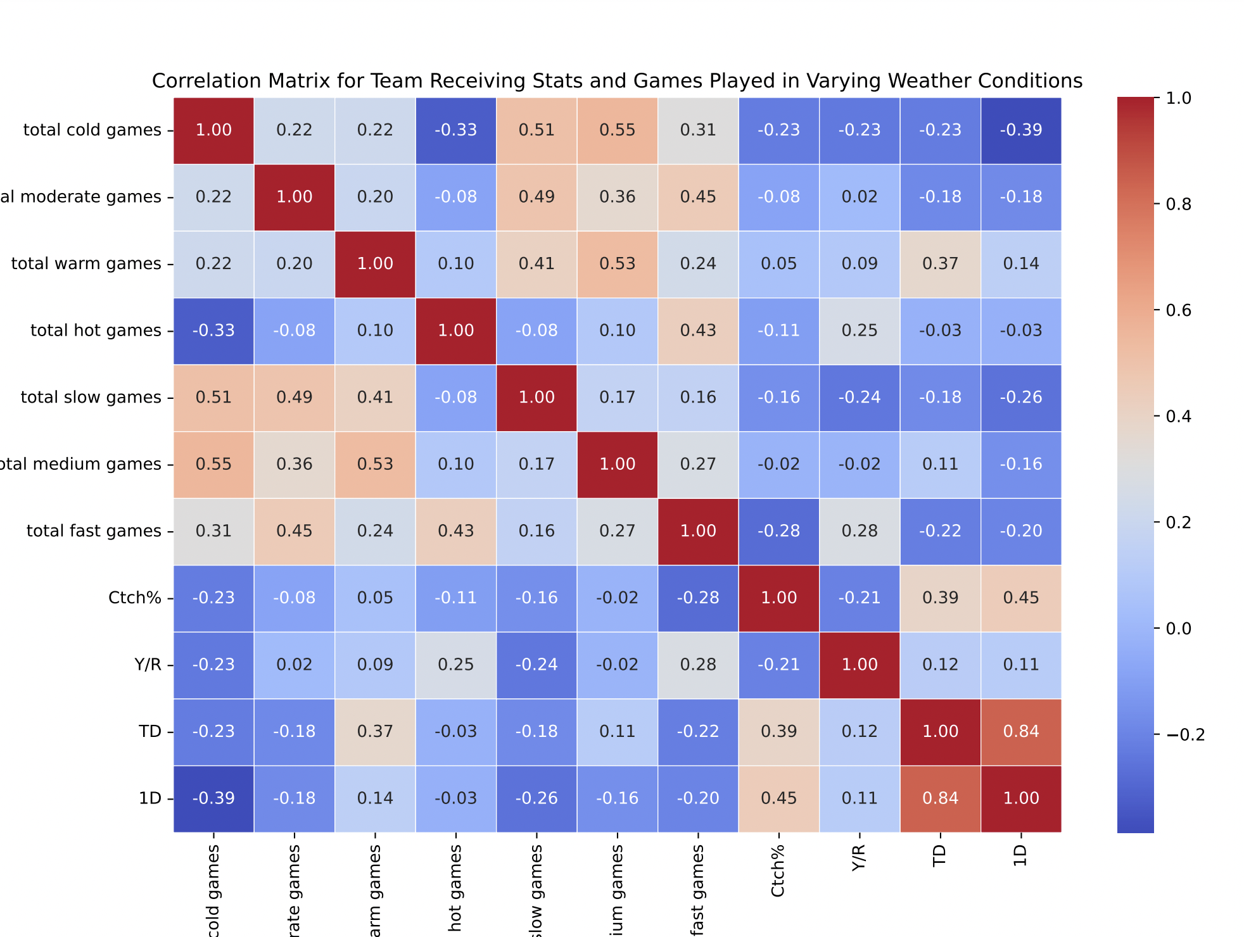
Weather vs. Receiving Stats
Notes:
Low positive correlation between TD and total warm games
Low negative correlation between 1D and total cold games

Slide 16
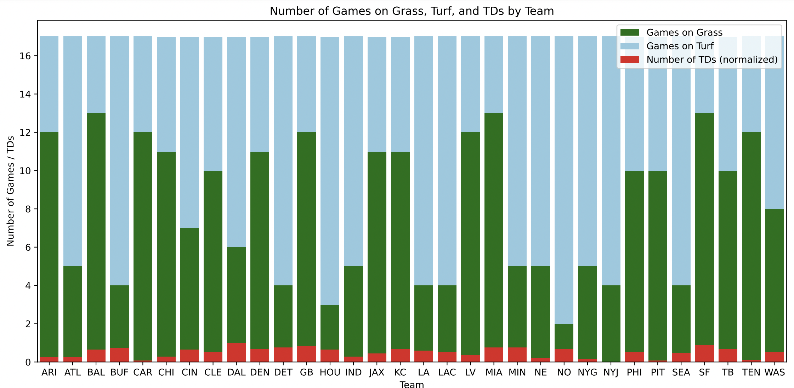
Surface vs. Receiving Stats
Notes:
No noticeable effect of surface on TDs by team – DAL has high TDs, plays most games on turf, MIA has high TDs, plays most games on grass, TEN has low TDs and plays on grass, NYG has low TDs and plays on turf

Slide 17
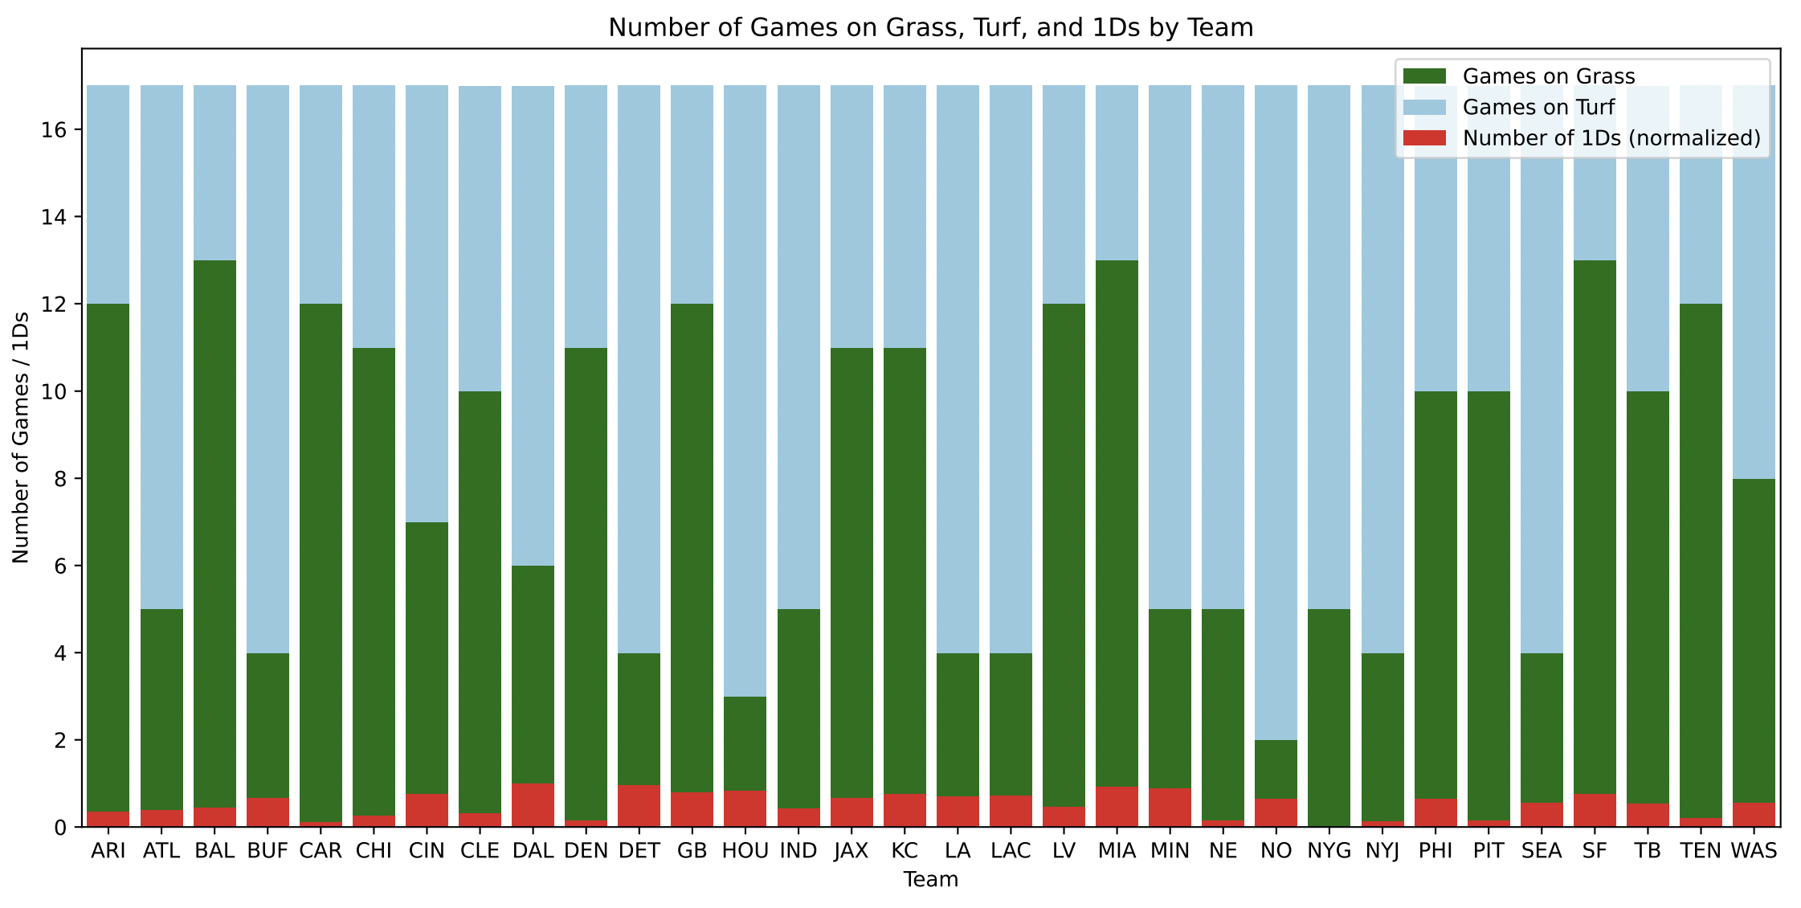
Surface vs. Receiving Stats
Notes:
Similar trends here

Slide 18
Discussion

Slide 19
Primary Takeaways
In 2023, the highest-powered passing offenses had the most Y/R, TDs, and 1D. Catch rate was less of a clear indicator of successful passing offenses.
There was a low positive correlation between total number of games played in warm temperatures (62-75 deg) and TDs (0.37), and a low negative correlation between total number of games played in cold temperatures (25-54) and 1Ds (-0.39).
Surface plays virtually no role in determining the total number of TDs and 1Ds for each team.

Slide 20
Limitations and Future Considerations
Larger sample size
Combination of categorical features
Predictive modelling techniques

